Slide 1
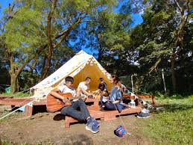
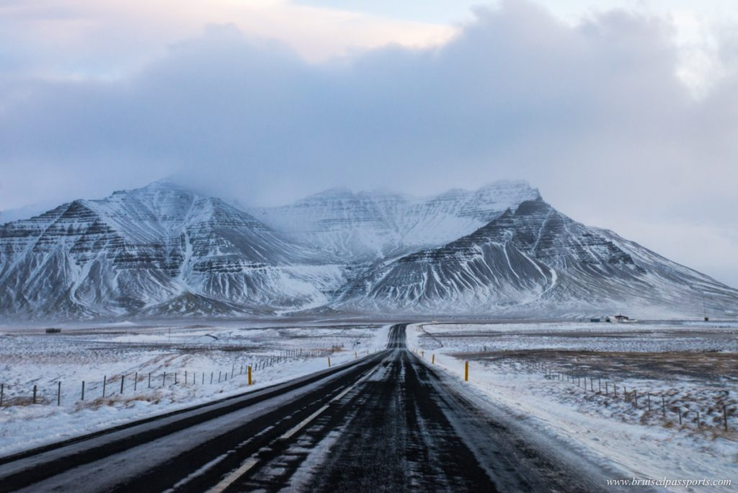

Scenario with Rain Prediction
 | Hong Kong Camping | Iceland Road Trip | Volunteer in Bethlehem
Pressure (hPa) | 1013 | 1007 | 1016
Temperature (°C) | 29.1 | 11.2 | 22.7
Humidity (%) | 69 | 80 | 75
Cloud (%) | 18 | 81 | 25
Sunshine (hour) | 6.2 | 2.4 | 9.8
Windspeed (km/hr) | 6 | 3.1 | 12.2
Rainfall (mm) | 2 | 3 | 0
Rain Probability | 0.11 | 0.76 | 0.01
Rain? | No | Yes | No

